Slide 1
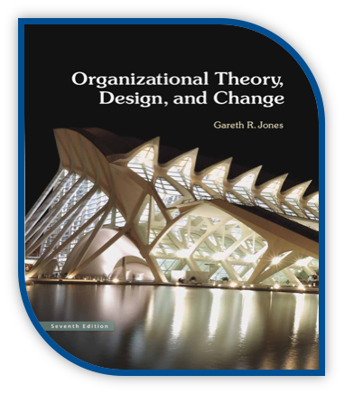
MSCI 311
Organizational Design and Technology
Instructor: Ayman Alzayat, aalzayat@uwaterloo.ca
TA: Varsha Suryanarayana, vsuryana@uwaterloo.ca

Slide 2
What will I learn in the following slides?
How do I measure organizational effectiveness?
The Goal Model
The System-Resource Model
The Internal Process Model
The Strategic Adaptation Model
March & Olsen Model of Organizational Learning

Slide 3
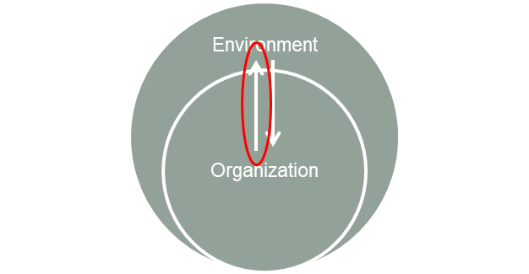
THE GOAL MODEL
Effectiveness = extent to which org. meets its various goals
Focus on the output: “Effectiveness is the extent to which a manager achieves the output requirements of his/her job”
Q : What are 'popular' goals that companies set that can be used to measure organizational effectiveness?

Slide 4
THE GOAL MODEL
Problems:
Multiple, conflicting goals which are difficult to prioritize
Definition of goals – goals change depending on the audience
Short vs. long term goals
Measurement of Goal Attainment
E.g., How do you measure morale?
Goals are ideal states

Slide 5
THE INTERNAL PROCESS MODEL
Effectiveness vs. efficiency
Efficiency = Output/Input
Q: What does this mean?
Issues with efficiency as a measure of effectiveness
Efficiency has narrow focus
Effectiveness of whole does not equal sum of efficiency of parts
Measurement difficulties
Pay attention to what is measurable and ignores less measurable activities (e.g., product recall)

Slide 6
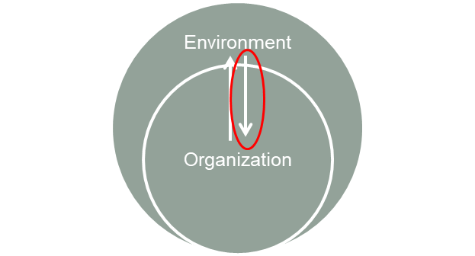
THE SYSTEM-RESOURCE MODEL
Effectiveness = extent to which org. can acquire needed (optimum) resources
Focus on the input: “Effectiveness is identifying scarce and valuable resources and ensuring their continued availability to the firm”
Q: What are some needed resources for an organization?

Slide 7
THE SYSTEM-RESOURCE MODEL
Problem:
Resource acquisition vs. use.
How well can the organization utilize valuable resources?
How well can the organization maintain a balance between acquiring and ensuring availability of resources in the future?

Slide 8
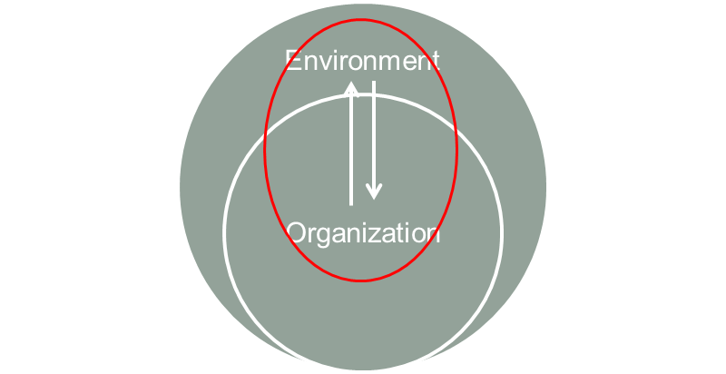
THE STRATEGIC ADAPTATION MODEL
Effectiveness = being attentive to the environment and quickly adapting to changes
Focus on both internal processes and the org. Environment interface
Effective organizations “get smart”
-Monitoring of environment
-Receive continuous feedback
-Take timely corrective actions

Slide 9
THE STRATEGIC ADAPTATION MODEL
The rational view of learning
Learning as ‘simple rational adaptation’
Decision maker knows the past and understands it
Lack of improvement blamed on org. rigidity, lack of motivation, etc.
What actually happens
Organizations make decisions based on ‘interpretation’ of experience
Goals may be ambiguous -> hard to categorize ‘success’ and ‘failure’
What happened, why it happened, and whether it was good, are not necessarily objectively determined

Slide 10
The March & Olsen complete cycle of choice
Individuals’ cognitions and preferences, ‘models of the world’
Individual actions or participation in a choice situation
Environmental Actions – or ‘responses’
Organizational actions: ‘choices’ or ‘outcomes’

Slide 11
The March & Olsen complete cycle of choice
Individuals’ cognitions and preferences, ‘models of the world’
Individual actions or participation in a choice situation
Environmental Actions – or ‘responses’
Organizational actions: ‘choices’ or ‘outcomes’
Do all individual cognitions and preferences transform into individual action? No, because:

Slide 12
The March & Olsen complete cycle of choice
Do all individual cognitions and preferences transform into individual action? No, because:
Capacity for beliefs, attitudes, and concerns is larger than the capacity for action
Only sometimes does a set of beliefs have behavioral implications
Organizations sometime need to formalize the channels by which individual cognitions/beliefs become actions:
‘Duty’ to act may come from roles, duties, and obligations

Slide 13
The March & Olsen complete cycle of choice
Individuals’ cognitions and preferences, ‘models of the world’
Individual actions or participation in a choice situation
Environmental Actions – or ‘responses’
Organizational actions: ‘choices’ or ‘outcomes’
Ideally, rational individual actions drive organizational action. But:

Slide 14
The March & Olsen complete cycle of choice
Ideally, rational individual actions drive organizational action. But:
In reality, organizational action is often not rational, but comes as a result of compromise between ‘interest groups’. Recall Carnegie Model
Organizational action is often more affected by external factors than internal ones
Conclusion: There’s a variable relation between individual and organizational action

Slide 15
The March & Olsen complete cycle of choice
Individuals’ cognitions and preferences, ‘models of the world’
Individual actions or participation in a choice situation
Environmental Actions – or ‘responses’
Organizational actions: ‘choices’ or ‘outcomes’
Ideally, the environment responds to organizational choices

Slide 16
The March & Olsen complete cycle of choice
Ideally, the environment responds to organizational choices
(Incorrect) assumption is that environment has ‘a schedule of responses to alternative actions on the part of the organization’
But, sometimes different actions have the same response, or the same action will elicit different responses

Slide 17
The March & Olsen complete cycle of choice
Individuals’ cognitions and preferences, ‘models of the world’
Individual actions or participation in a choice situation
Environmental Actions – or ‘responses’
Organizational actions: ‘choices’ or ‘outcomes’
Ideally, the environment responds to organizational choices

Slide 18
The March & Olsen complete cycle of choice
Ideally, the environment responds to organizational choices
Based on the assumption that individual has perfect knowledge of what happened and why it happened
But, environment is too complex; hard to figure out
Belief depends on interpretation of experience, personal ‘model’.

Slide 19

Incomplete Learning Cycles
Role – constrained learning
The complex social structure inhibits the modification of individual behaviour on the basis of individual learning
Learning under ambiguity
Not clear what happened or why it happened
Individuals’ cognitions and preferences, ‘models of the world’
Individual actions or participation in a choice situation
Environmental Actions – or ‘responses’
Organizational actions: ‘choices’ or ‘outcomes’
Audience learning
Individual doesn’t affect organizational action
Individuals have learned, but organization doesn’t adapt
Superstitious learning
Org. behaviour is modified but the org. action does not affect the environment significantly.
Notes:
In summary, the learning cycle can break at any of the links.

Slide 20
Effectiveness Summary
Comparison of effectiveness and efficiency
Models for measuring organizational effectiveness
The Goal Model
The System Resource Model
The Internal Process Model
The Strategic Adaptation Model
March & Olsen model

